Slide 1
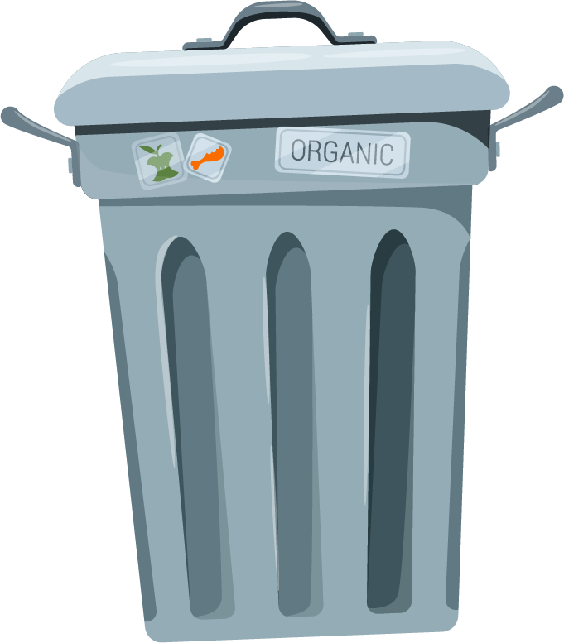



Tackling Food Waste: A Smart Solution
By Philip, Dimitris, George and Odysseas

Slide 2
01
The Food Waste Crisis

Slide 3
Food waste consequences
01
Emissions of greenhouse gases
02
Wastage of resources
03
Loss of soil fertility
04
Contamination of water
05
Hunger and denutrition

Slide 4


Approximately 1/3 of all food produced globally is lost or wasted, totalling around 1.05 billion tons annually.
This waste is equivalent to about 1 billion meals lost each day.
The UK wastes around 9.5 million tonnes of food each year, enough to feed over 30 million people.
Households account for 70% of this waste, with an estimated value of £14 billion wasted annually.
Food waste generates approximately 25 million tonnes of greenhouse gas emissions in the UK each year.
Globally, food waste accounts for about 6% of total greenhouse gas emissions.
On average, each person in the UK wastes around 70 kg of food per year, equivalent to about 140 meals.
Despite sufficient global food production, nearly 800 million people still experience hunger.

Slide 5
02
The Personal Impact

Slide 6

Each of us contributes to food waste.
If we can reduce this waste, we are one step closer to achieving zero hunger.

Slide 7
Our Solution
03

Slide 8
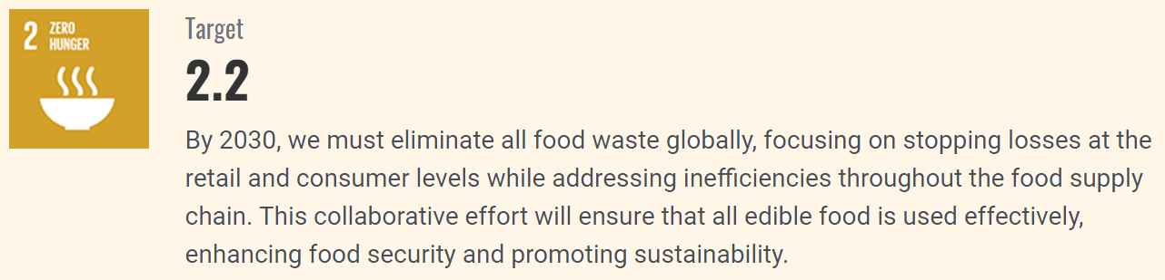
We’ve developed a smart waste management system designed specifically for restaurants.
This system tracks uneaten food and provides valuable data to help restaurant owners optimize their operations from both a financial perspective and a sustainability perspective.

Slide 9
How It Works
04

Slide 10

1. Before clearing a plate, the server places it on a designated platform.
2. The server selects the meal type from an intuitive interface.
3. An Arduino Uno processes this information and updates the owner’s database with critical data on food waste.
4. Our AI models process the data and suggest improvements to portion sizes or cost.

Slide 11
Benefits For Restaurant Owners
05

Slide 12

1. Reducing food waste leads to cost savings on inventory.
2. Helps adjust portion sizes based on actual consumption patterns.
3. Provides insights that can lead to more efficient operations and reduced losses from unsold dishes.

Slide 13
Real-World Applications
06

Slide 14
Imagine this system being implemented in various dining establishments:
Fast-food chains
Casual dining restaurants
Fine dining establishments
Each can benefit from understanding their food waste patterns and making adjustments accordingly.

Slide 15
Future Developments
07

Slide 16
How we envision expanding our system's capabilities:
-Use fiducials or QR codes to recognise the different plates.
-Find a more accurate load cell to measure weight
Partnering with local food banks to redistribute the minimised surplus food effectively.

Slide 17
Thank you!

